Slide 1
Network Theorems

Slide 2
SUPERPOSITION THEOREM
If a circuit has two or more independent sources, one way to determine the value of a specific variable (voltage or current) is to use nodal or mesh analysis.
Another way is to determine the contribution of each independent source to the variable and then add them up. The latter approach is known as the superposition.
The idea of superposition rests on the linearity property.

Slide 3
STATEMENT
“The superposition principle states that the voltage across (or current through) an element in a linear circuit is the algebraic sum of the voltages across (or currents through) that element due to each independent source acting alone”.
NOTE: Superposition is not limited to circuit analysis but is applicable in many fields where cause and effect bear a linear relationship to one another.

Slide 4
The principle of superposition helps us to analyze a linear circuit with more than one independent source by calculating the contribution of each independent source separately.
However, to apply the superposition principle, we must keep two things in mind:
1. We consider one independent source at a time while all other independent sources are turned off. This implies that we replace every voltage source by 0 V (or a short circuit), and every current source by 0 A (or an open circuit). This way we obtain a simpler and more manageable circuit.
2. Dependent sources are left intact because they are controlled by circuit variables.

Slide 5
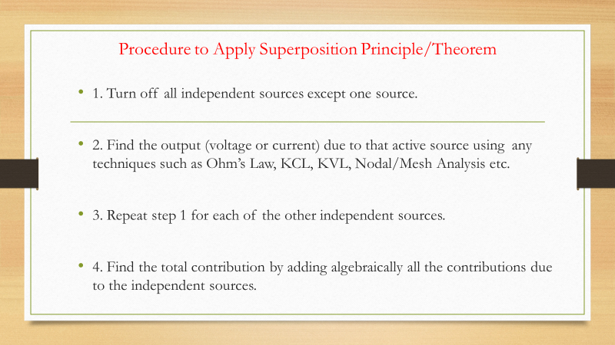

Slide 6
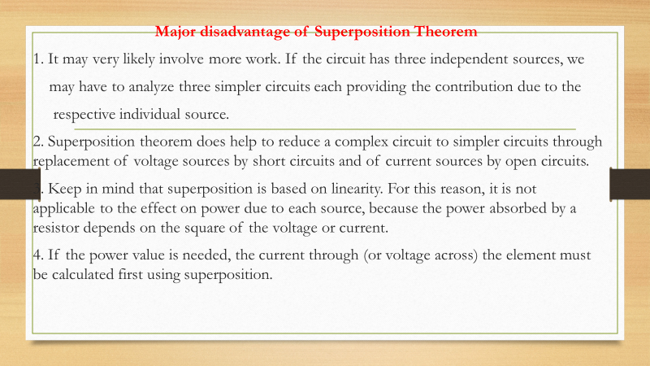

Slide 7
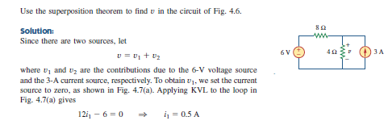
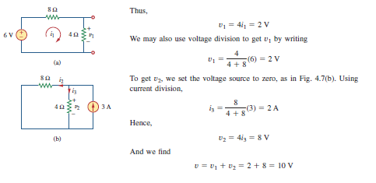
Numerical Problem

Slide 8
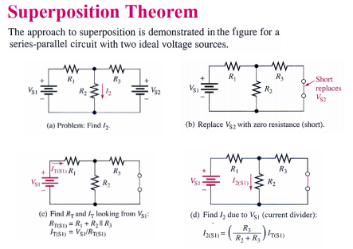

Slide 9
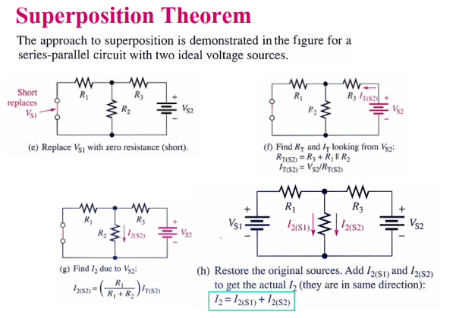

Slide 10
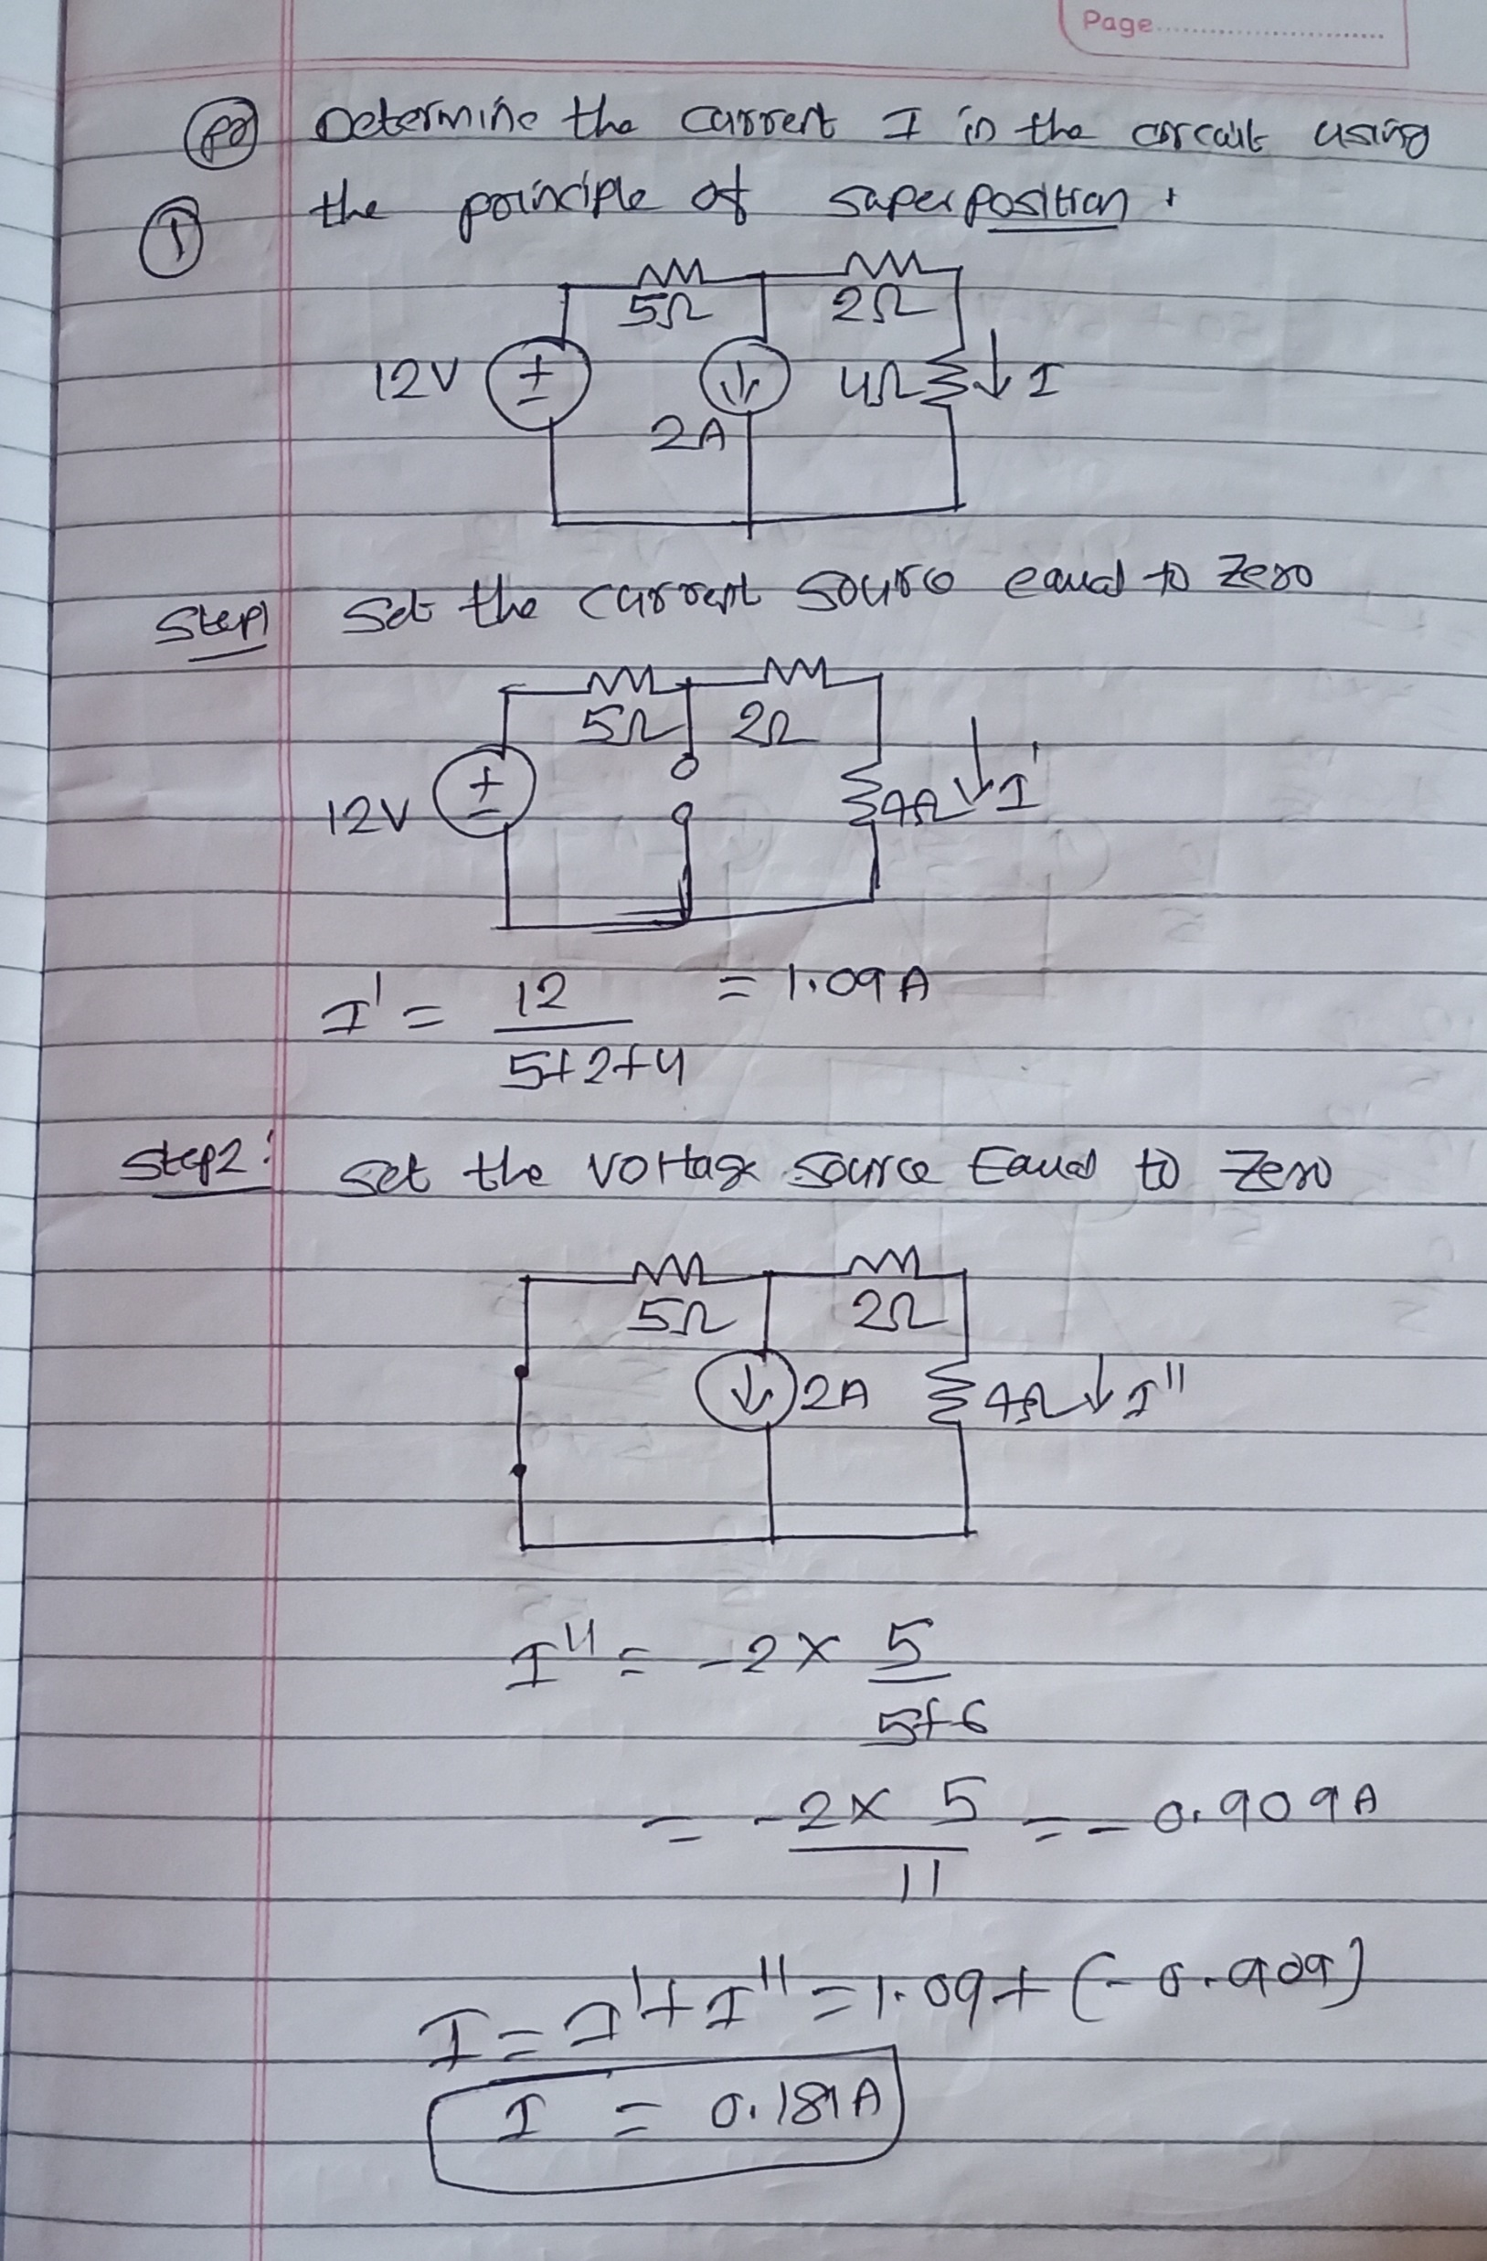

Slide 11
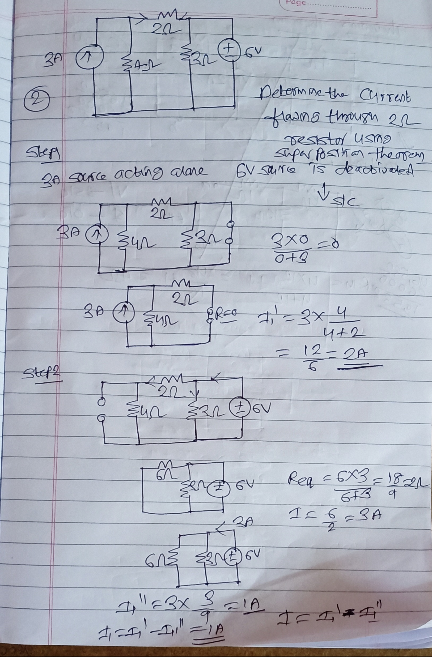

Slide 12
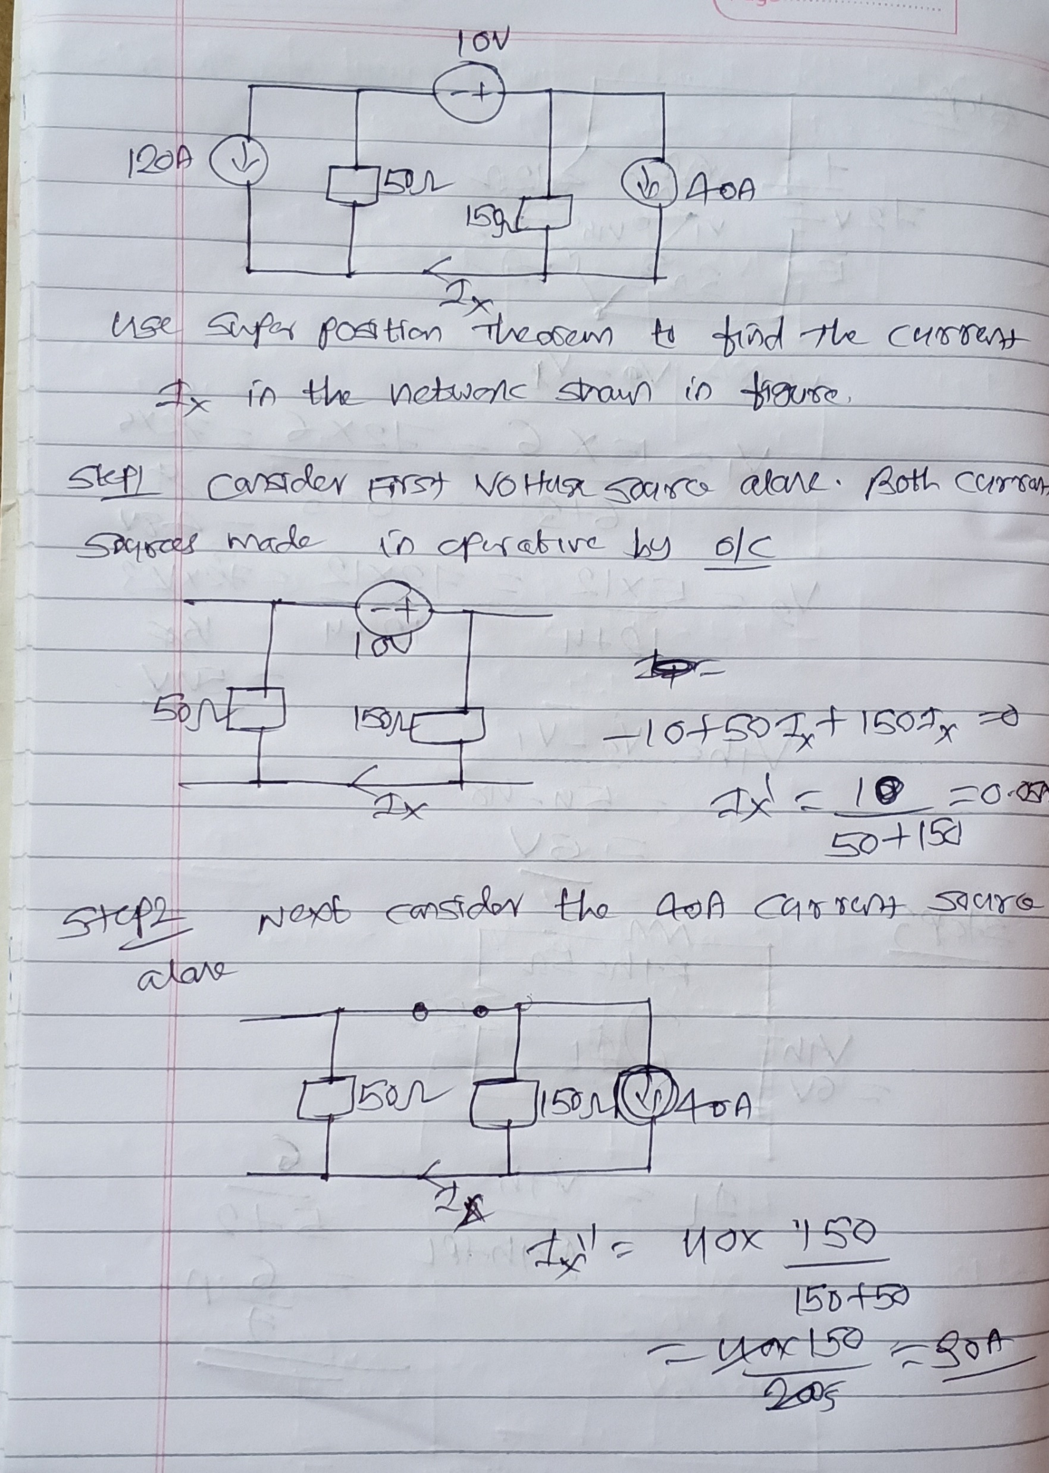

Slide 13
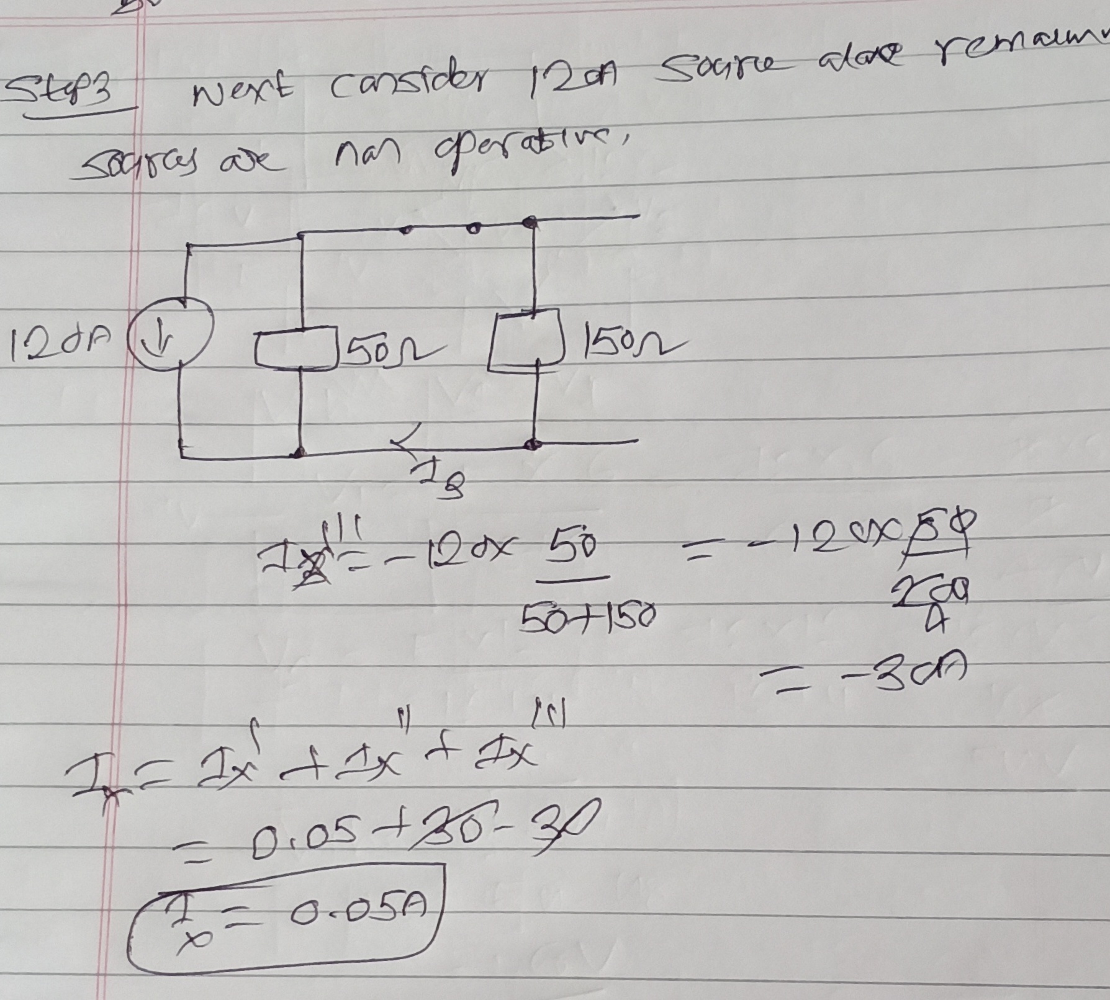

Slide 14
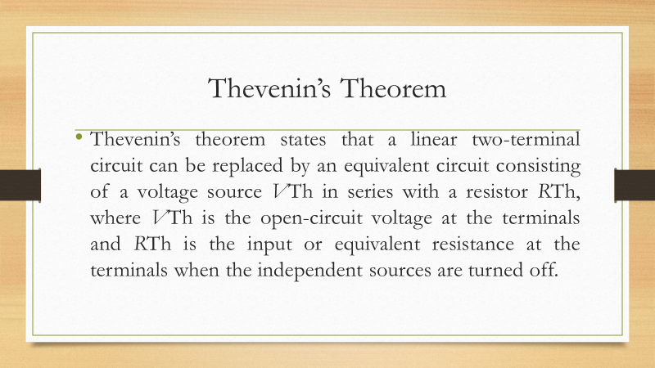

Slide 15
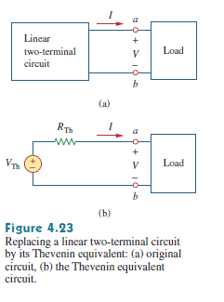

Slide 16
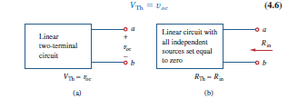

Slide 17
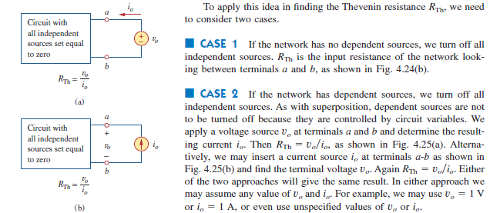

Slide 18
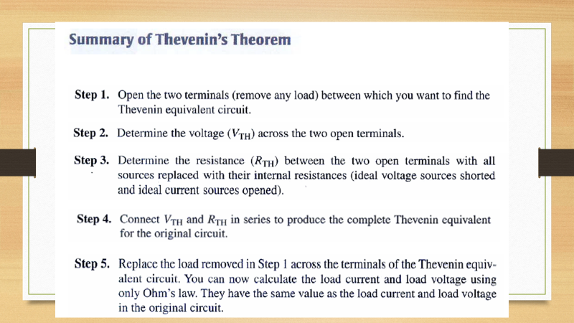

Slide 19
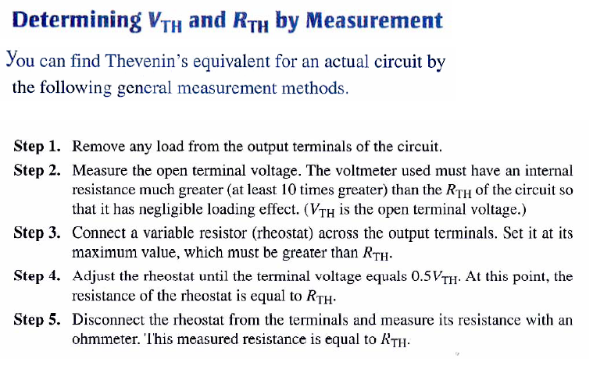

Slide 20
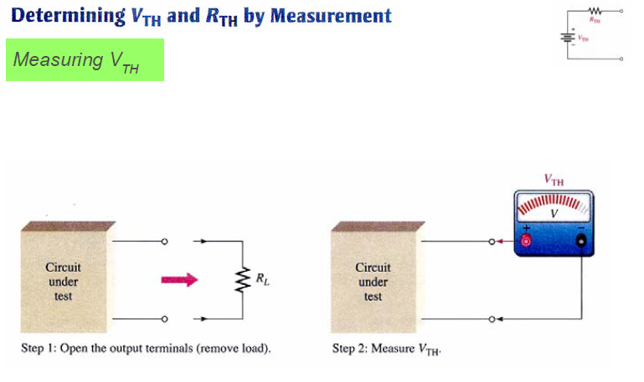

Slide 21
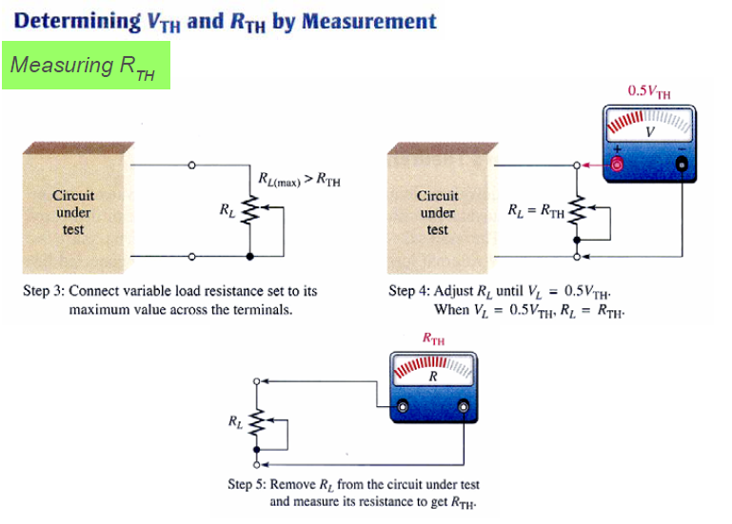

Slide 22
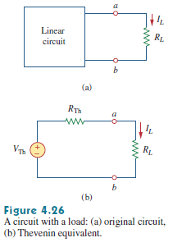

Slide 23
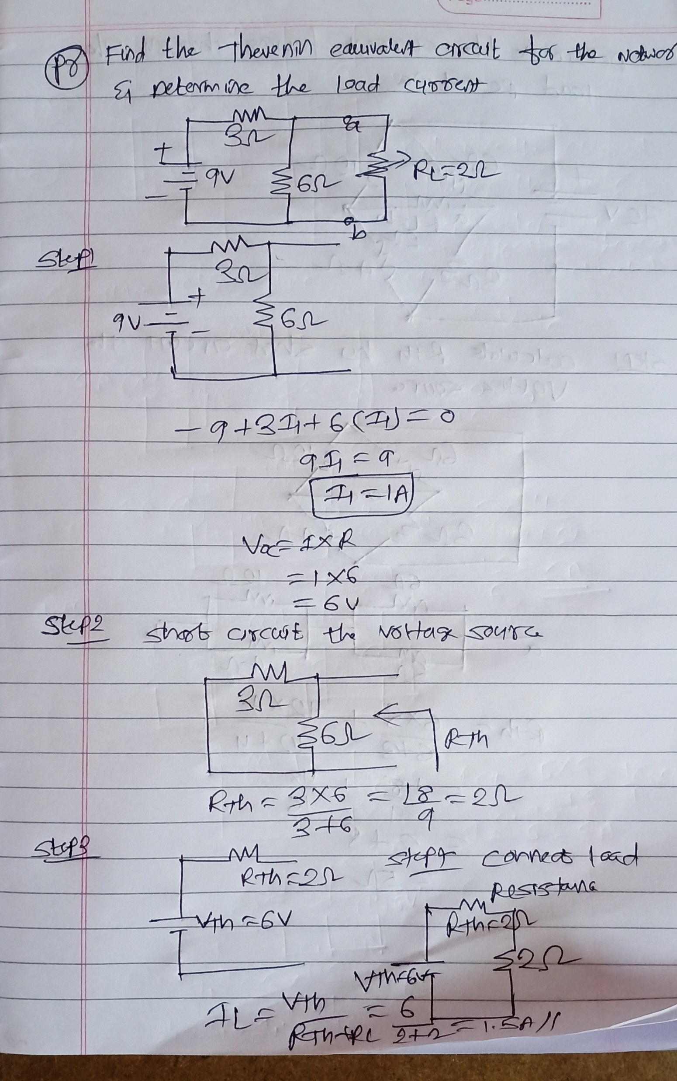

Slide 24
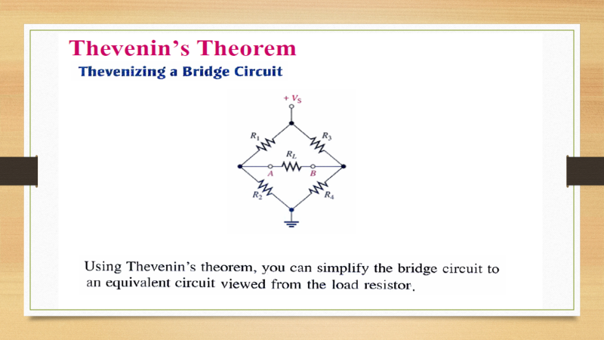

Slide 25
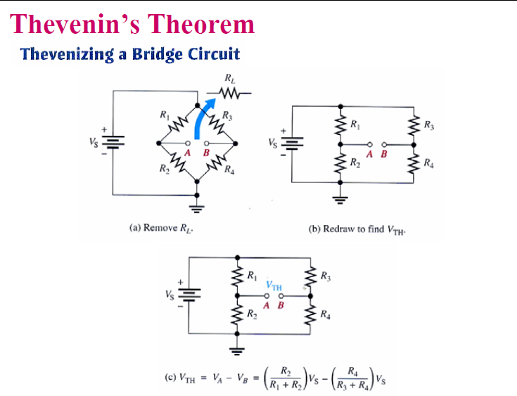

Slide 26
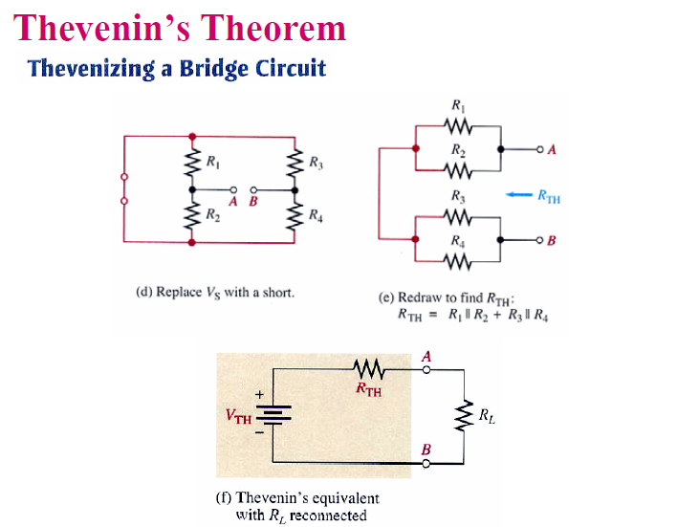

Slide 27
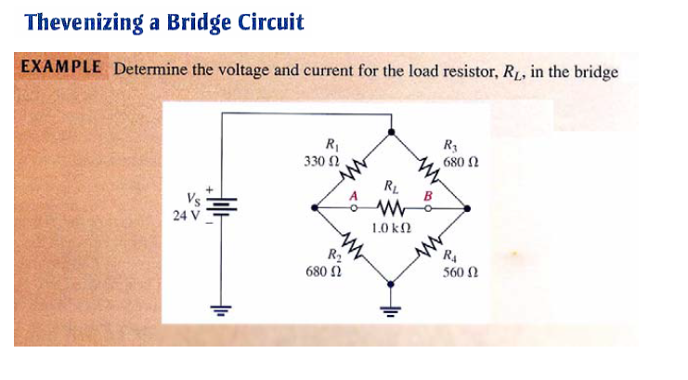

Slide 28
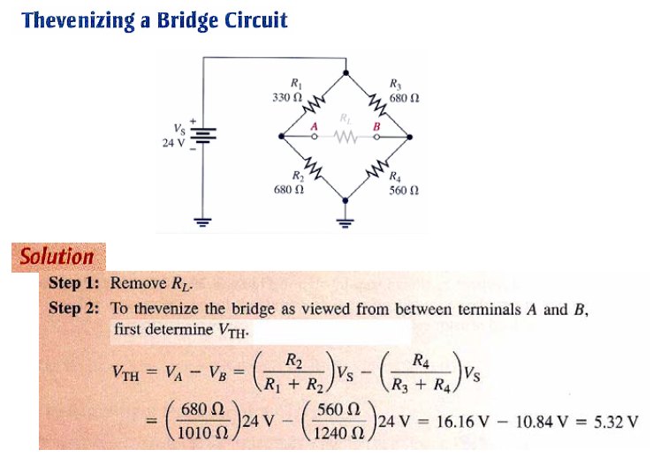

Slide 29
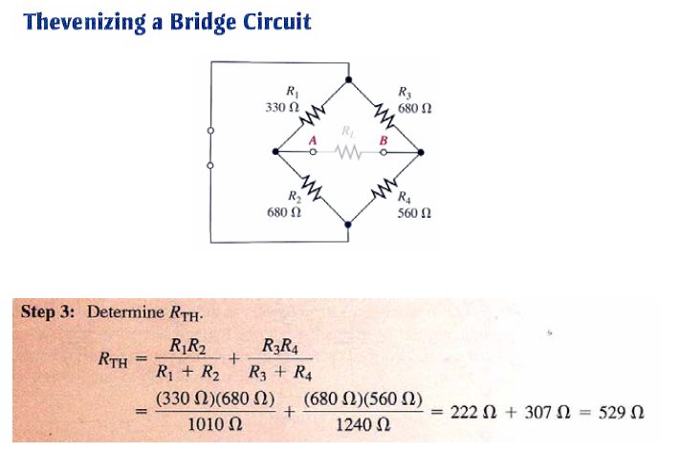

Slide 30
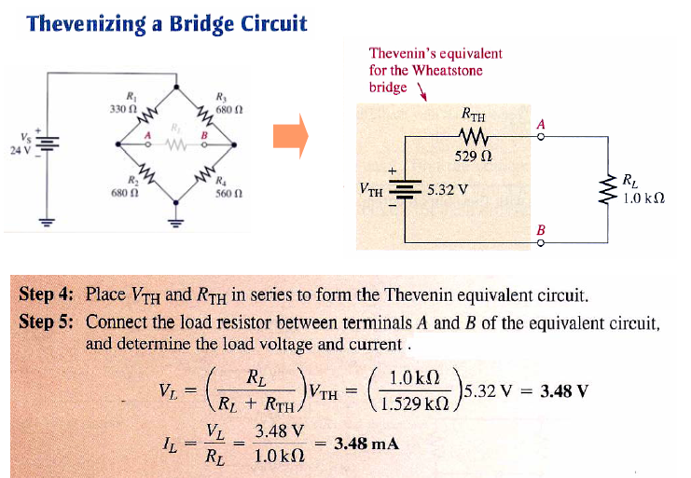

Slide 31
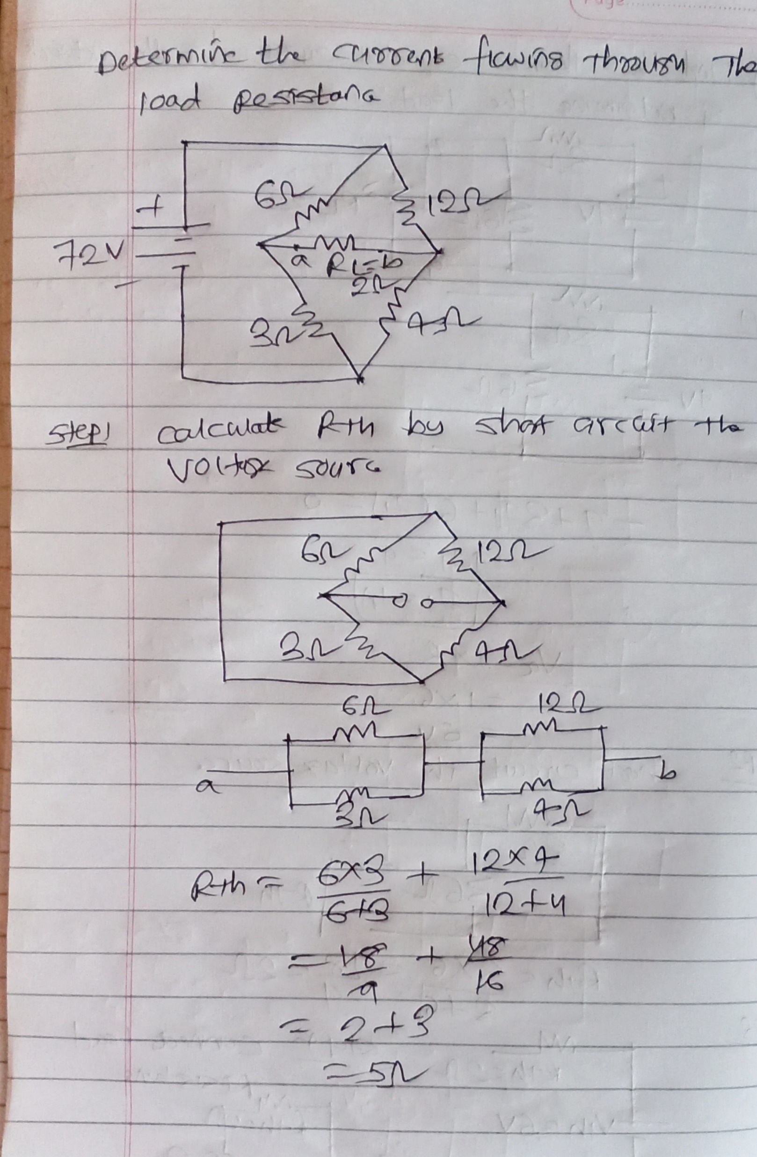

Slide 32
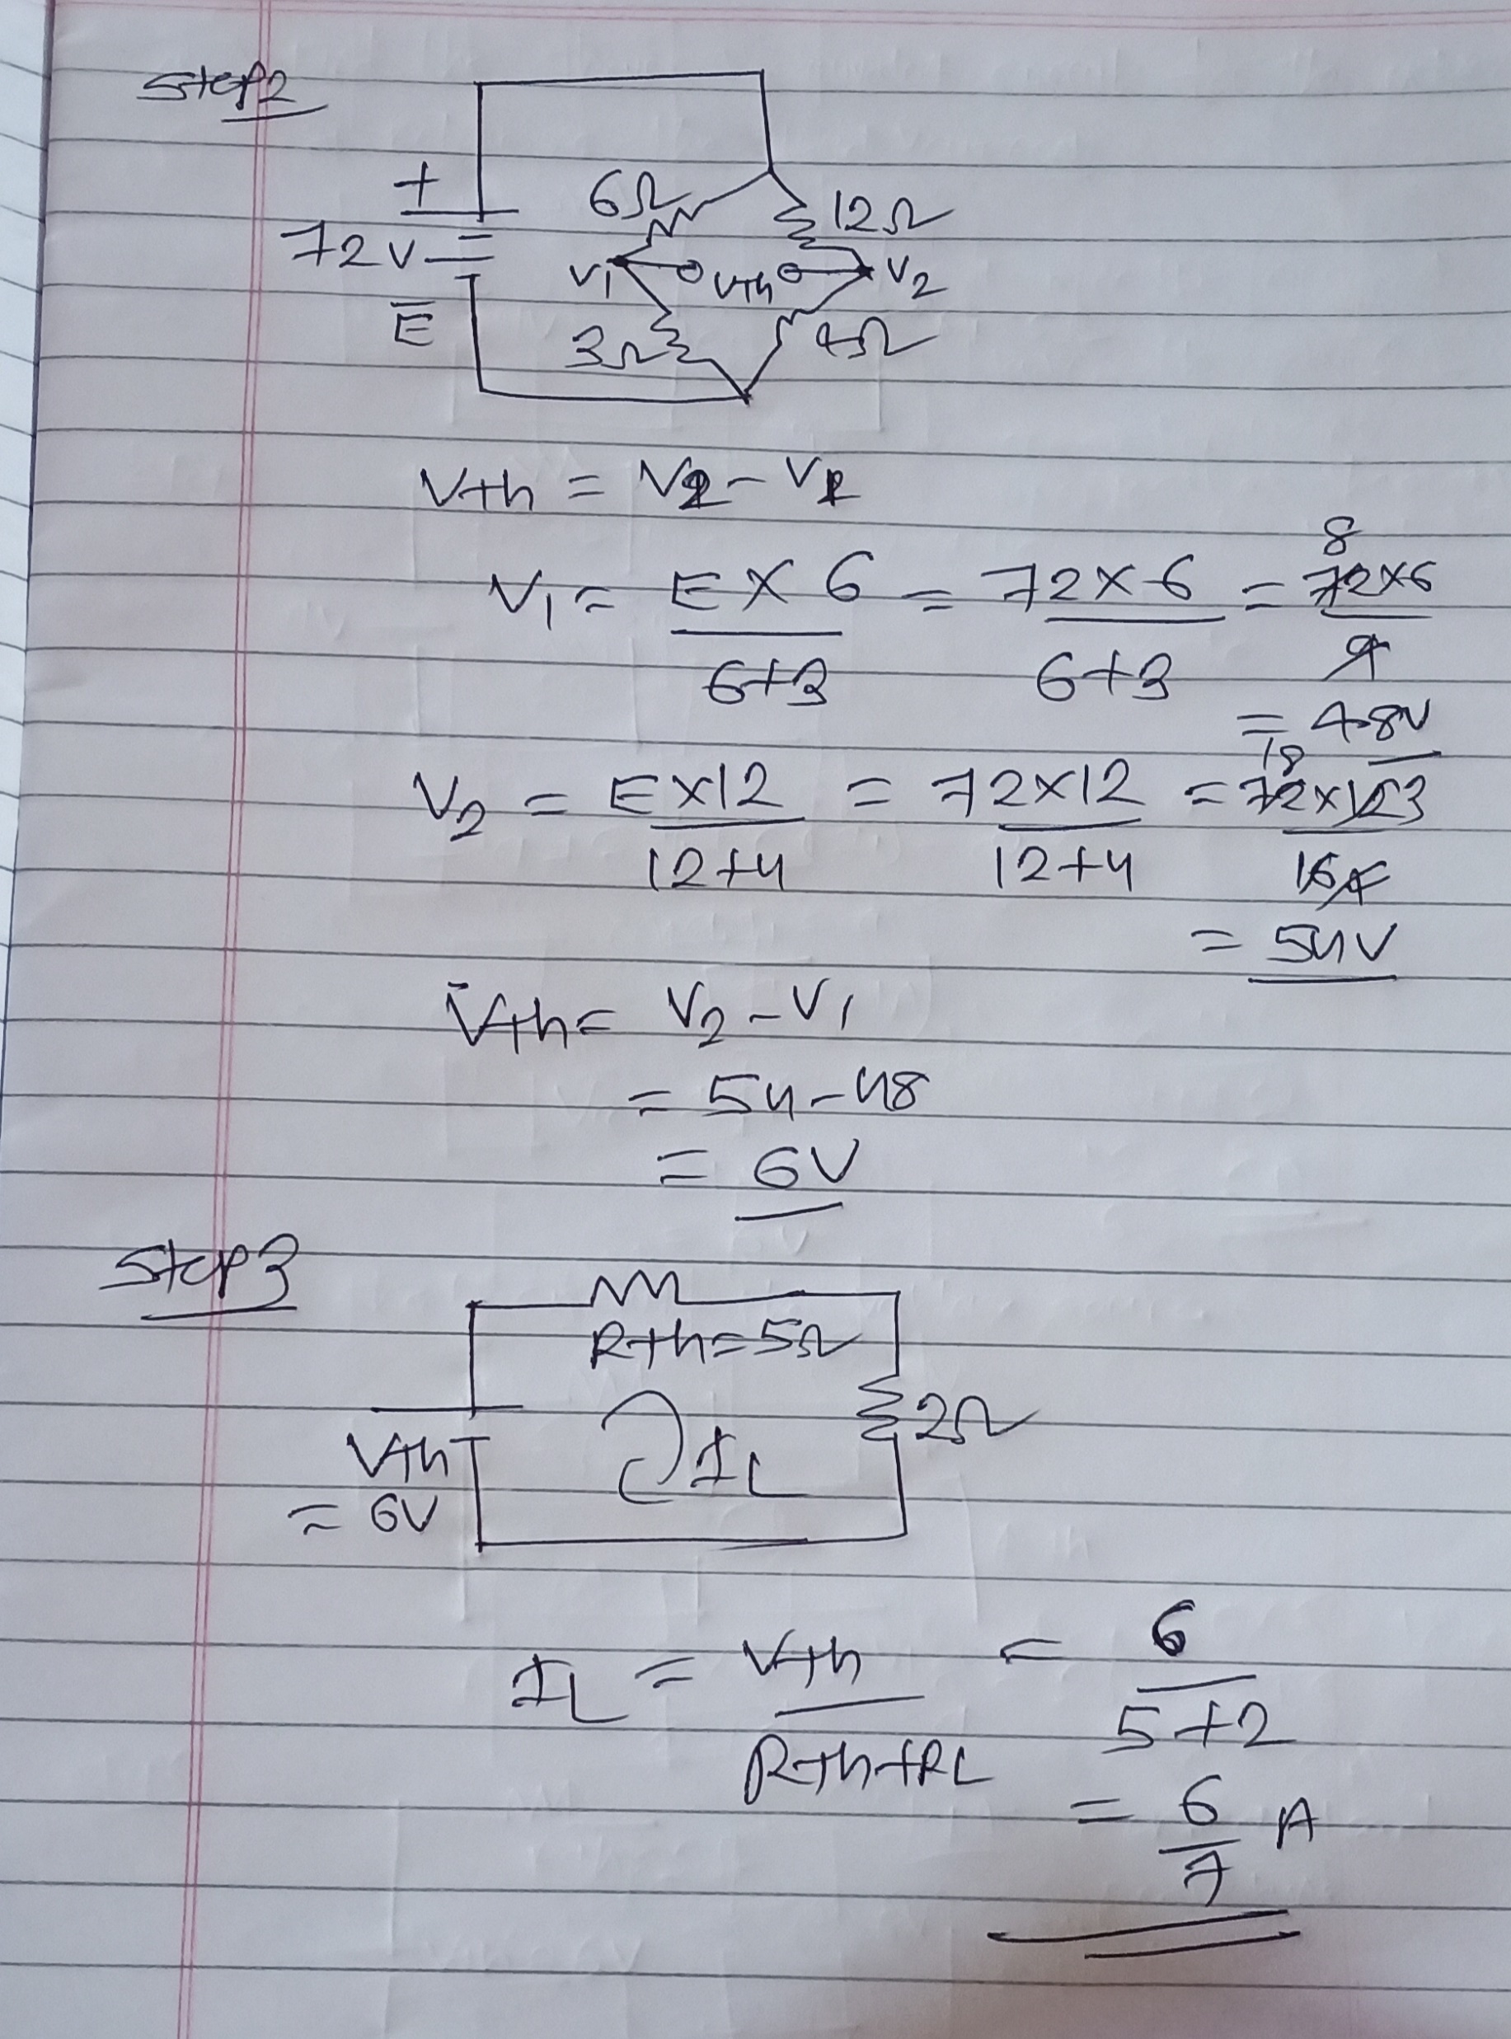

Slide 33
Norton's Theorem
Norton’s Theorem states that it is possible to simplify any linear circuit, no matter how complex, to an equivalent circuit with just a single current source and parallel resistance connected to a load.

Slide 34
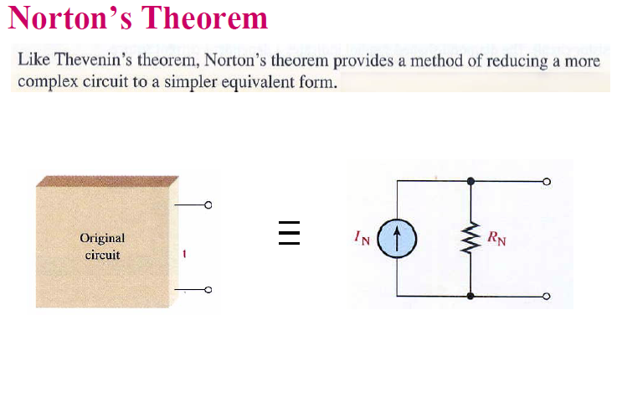

Slide 35
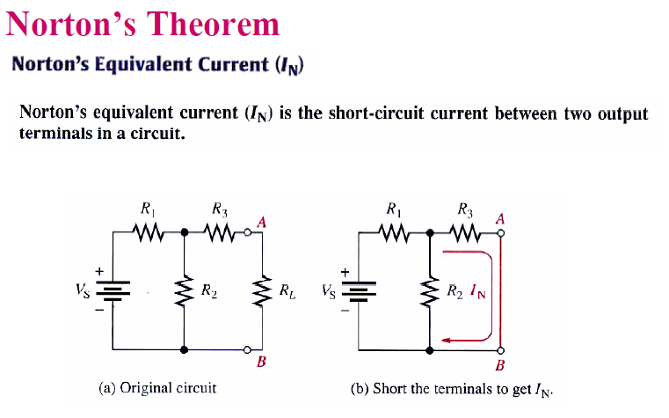

Slide 36
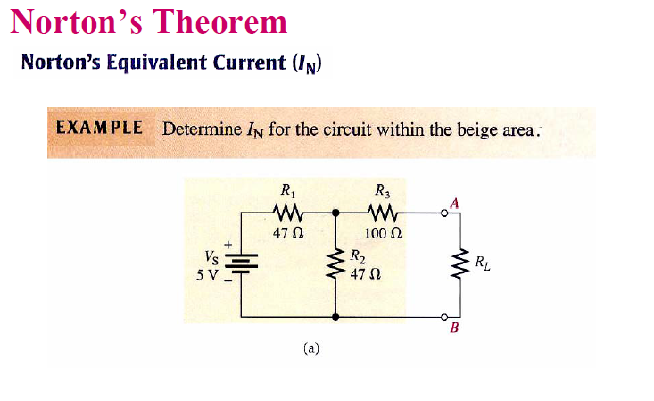

Slide 37
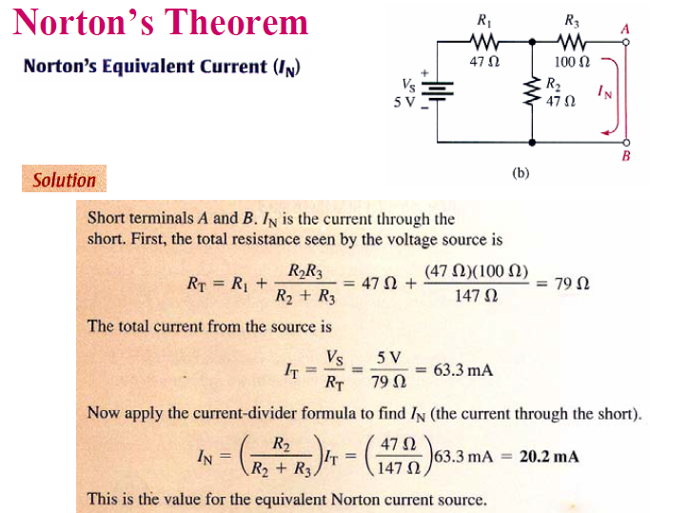

Slide 38
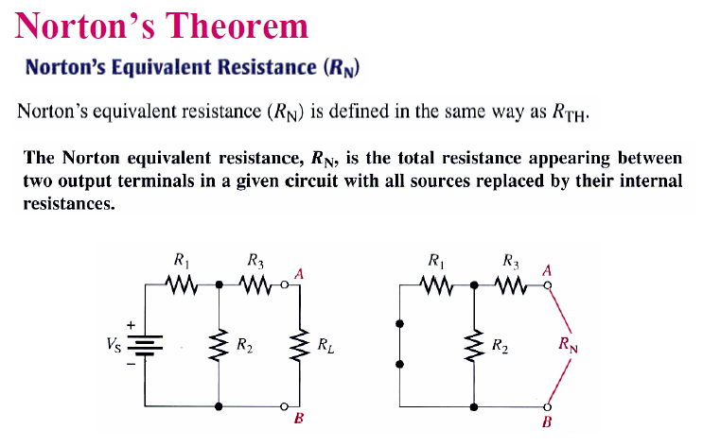

Slide 39
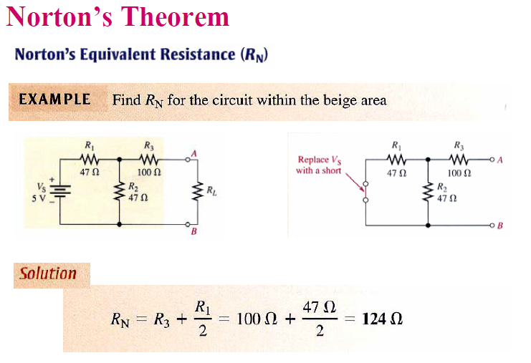

Slide 40
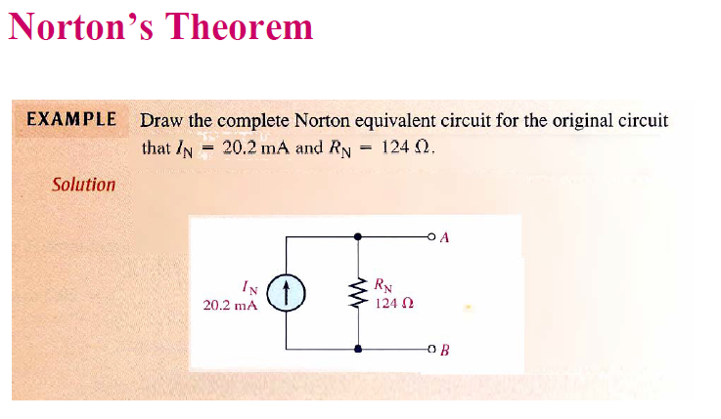

Slide 41
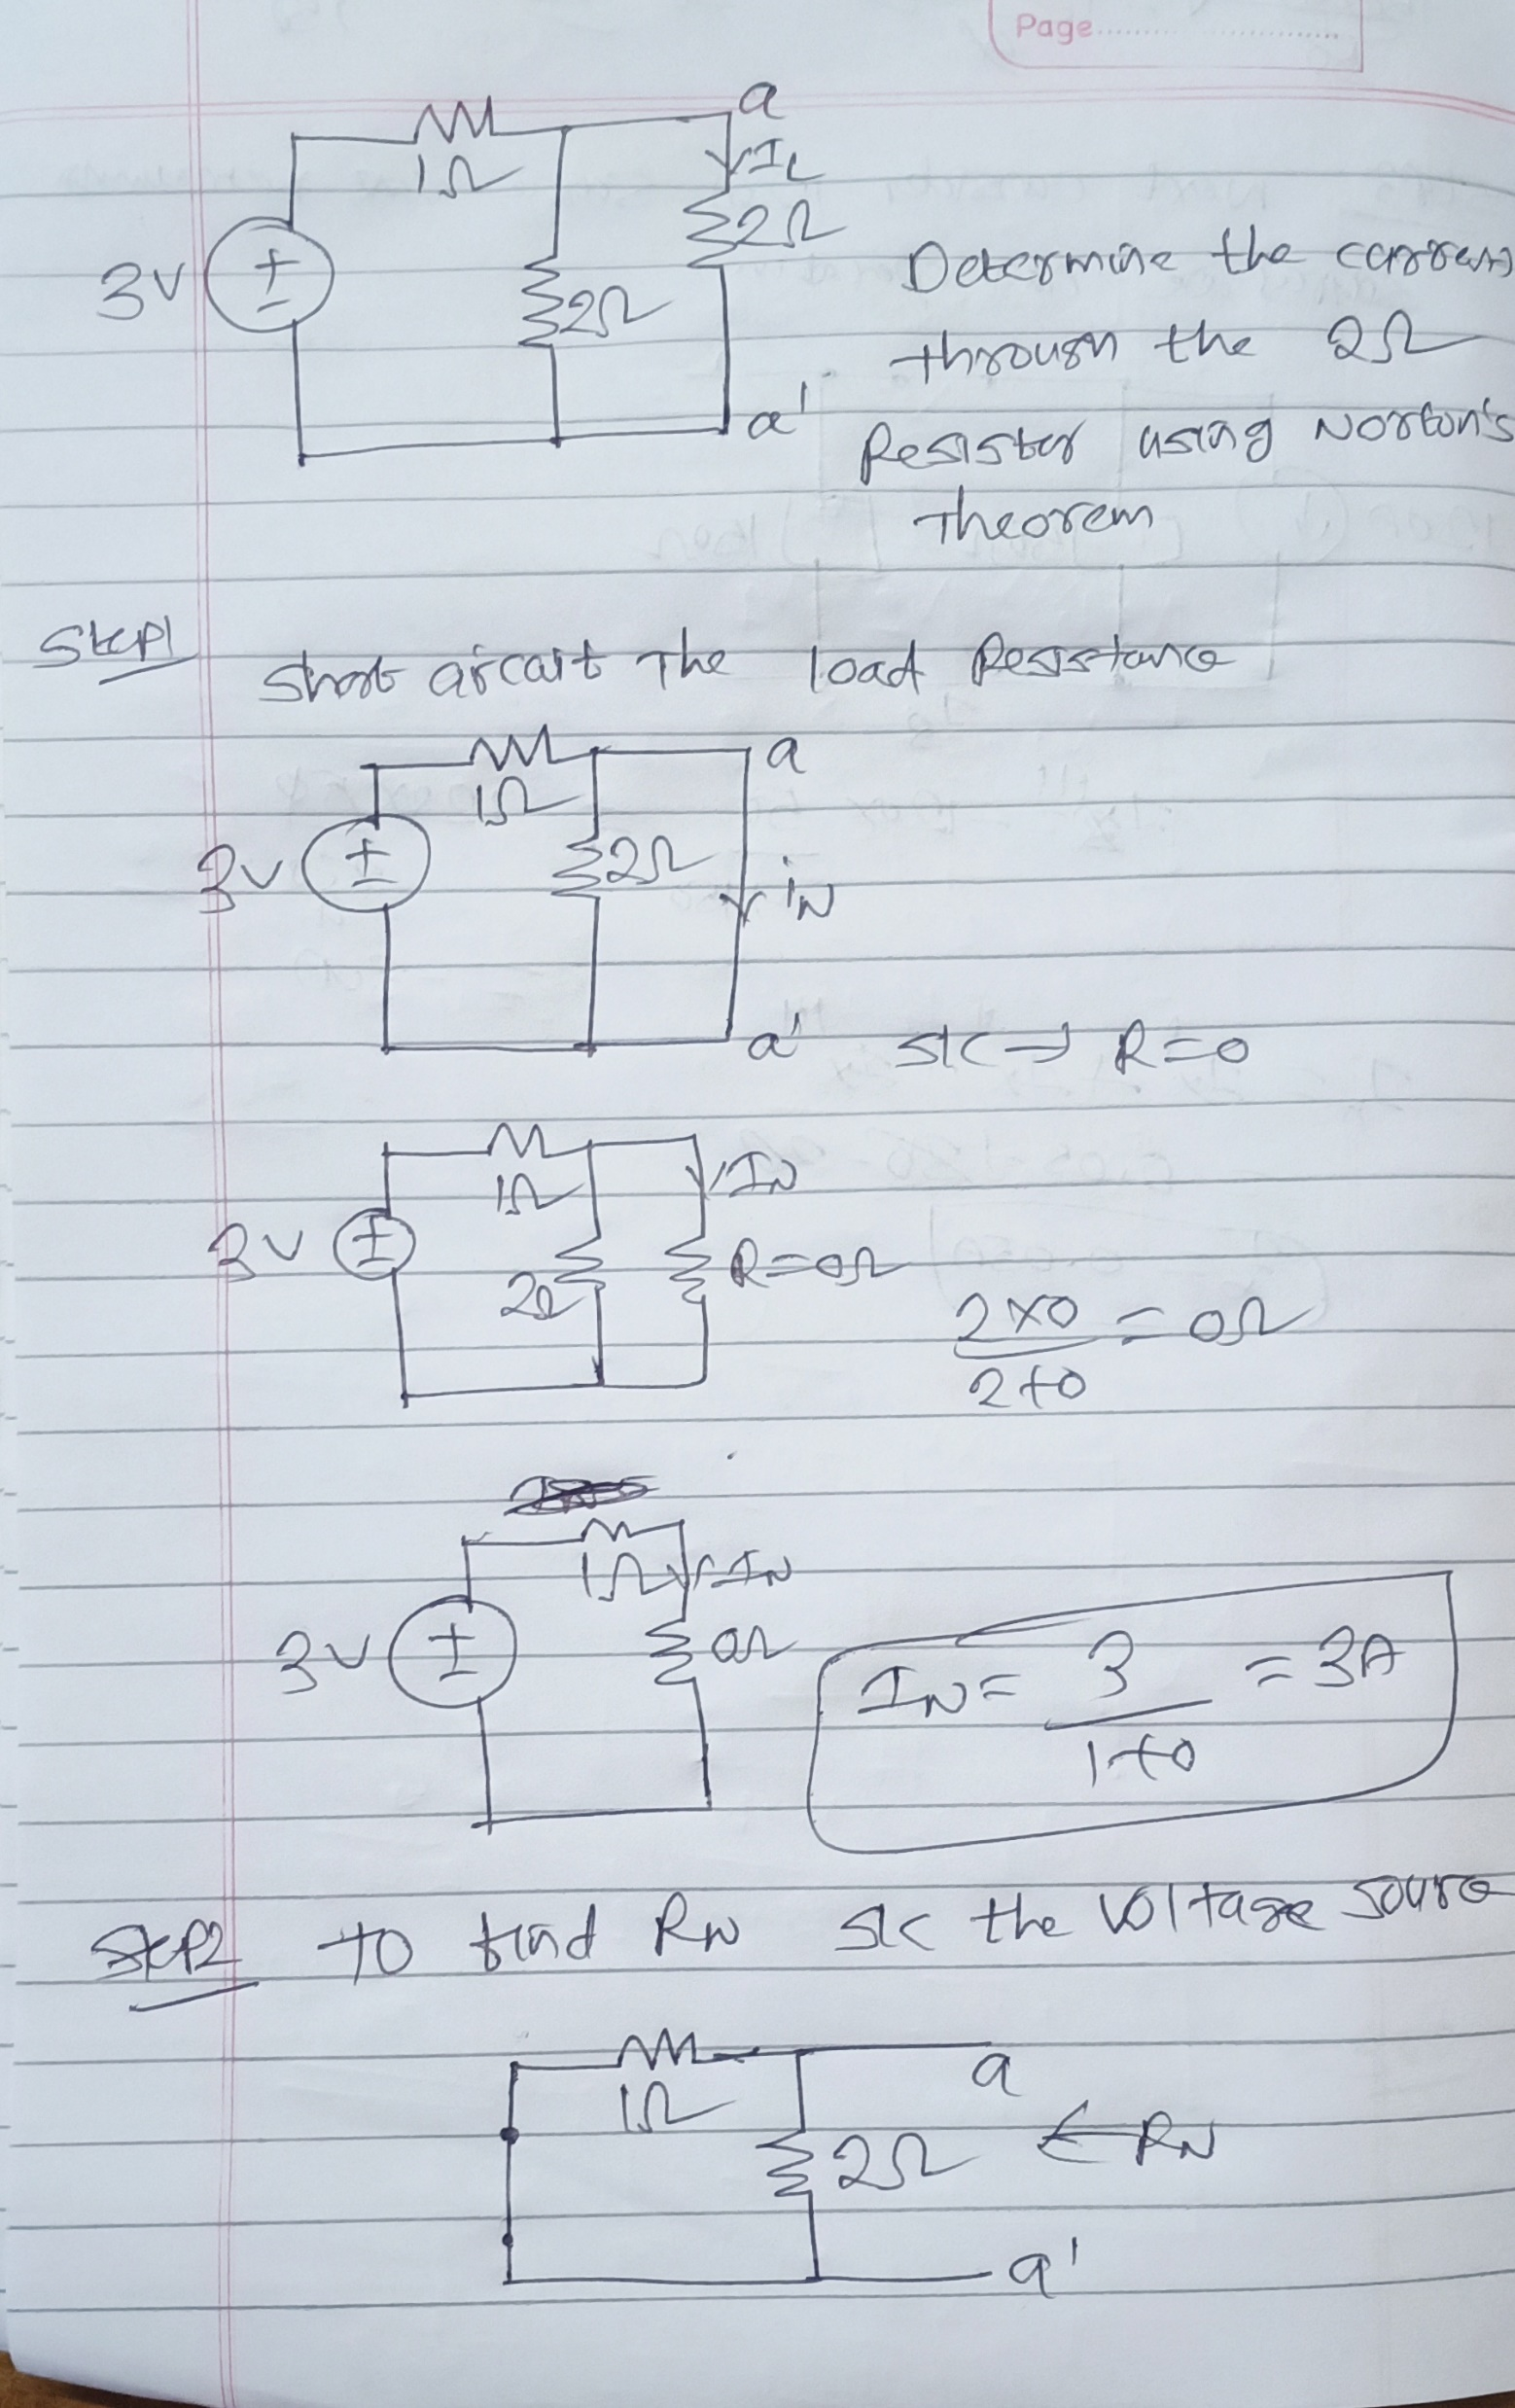

Slide 42
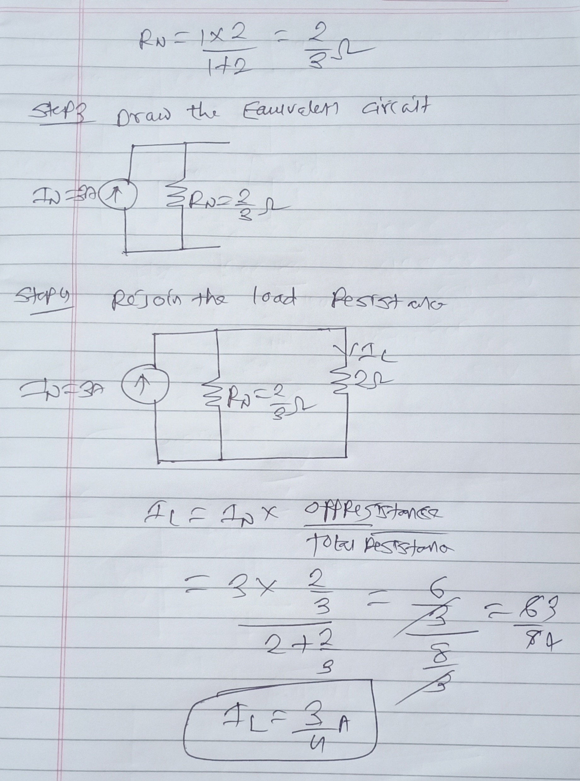

Slide 43
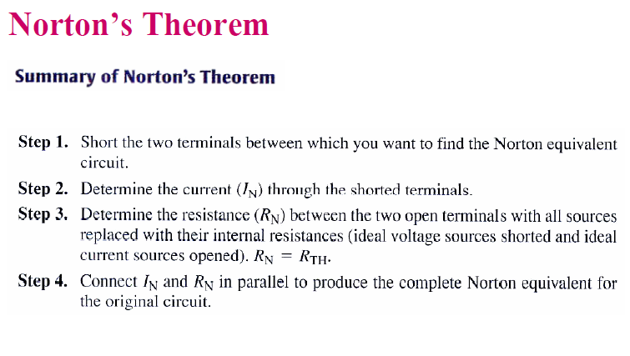

Slide 44
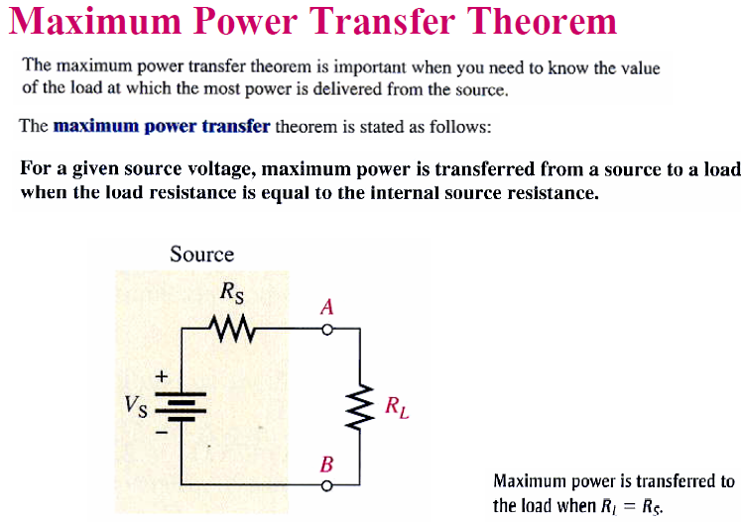

Slide 45
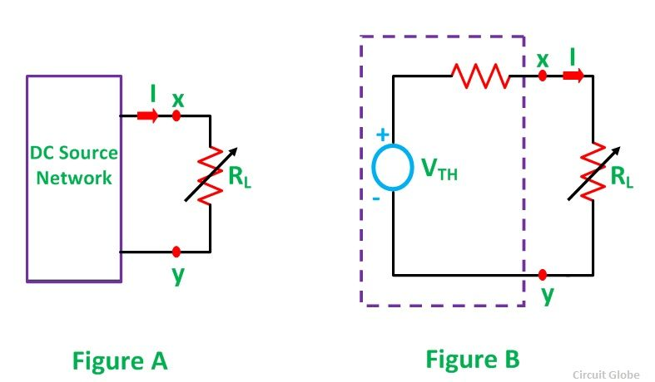
Maximum Power Transfer Theorem

Slide 46
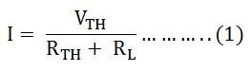
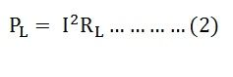
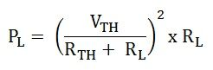
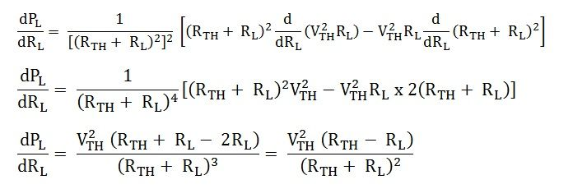
Derivation for maximum power transfer theorem

Slide 47
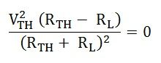
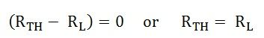
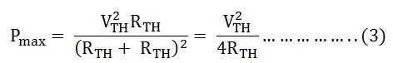
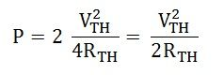
But as we know, (dP_{L}/dR_{L}) = 0

Slide 48
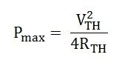
Steps for Solving Network Using Maximum Power Transfer Theorem
Following steps are used to solve the problem by Maximum Power Transfer theorem
Step 1 – Remove the load resistance of the circuit.
Step 2 – Find the Thevenin’s resistance (R_{TH}) of the source network looking through the open-circuited load terminals.
Step 3 – As per the maximum power transfer theorem, this R_{TH} is the load resistance of the network, i.e., R_{L} = R_{TH} that allows maximum power transfer.
Step 4 – Maximum Power Transfer is calculated by the equation shown below

Slide 49


Slide 50


Slide 51


Slide 52


Slide 53


Slide 54


Slide 55


